Slide 1
What is network media and its types
:- Network media refers to the communication channels used to interconnect nodes on a computer network. Typical examples of network media include copper coaxial cable, copper twisted pair cables and fiber-optic cables used in wired networks, and radio waves used in wireless data communications networks.

Slide 2
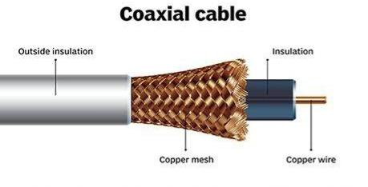
Copper coaxial cable
:- Coaxial cable is a type of copper cable specially built with a metal shield and other components engineered to block signal interference. A coaxial – or coax – cable is primarily used by cable TV companies to connect their satellite antenna facilities to customer homes and businesses.

Slide 3
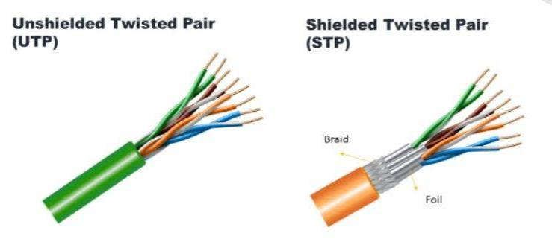
Twisted – Pair Cable
:- A twisted-pair cabling system is a cable consisting of one or several pairs of copper wires. These wires are twisted together and around each other and are insulated with a dielectric polymeric compound. Twisting helps minimize electromagnetic radiation and resists external interference.

Slide 4
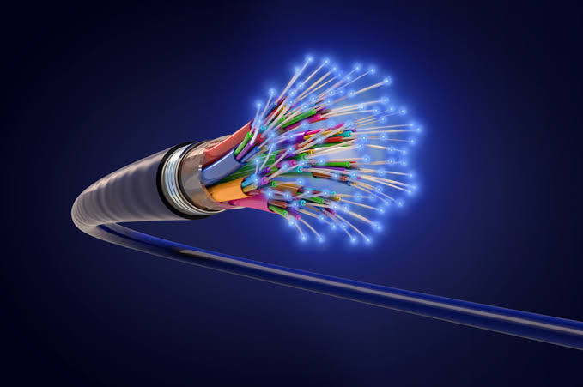
Fiber – Optic Cable
:- A fiber-optic cable, also known as an optical-fiber cable, is an assembly similar to an electrical cable but containing one or more optical fibers that are used to carry light. The optical fiber elements are typically individually coated with plastic layers and contained in a protective tube suitable for the environment where the cable is used.

